Slide 1

WESTGATE RESORTS
Housekeeping Supervisor Inspection
Training 2018

Slide 2

Focus
Supervisor focus in a room should be completion of unit readiness for guest occupancy.
Complete placement of any décor
Set unit thermostat to proper setting (i.e. 72 degrees)
Ensure all exterior and connecting doors are locked
Stand at entrance, review unit presentation and make final corrections prior to exiting

Slide 3
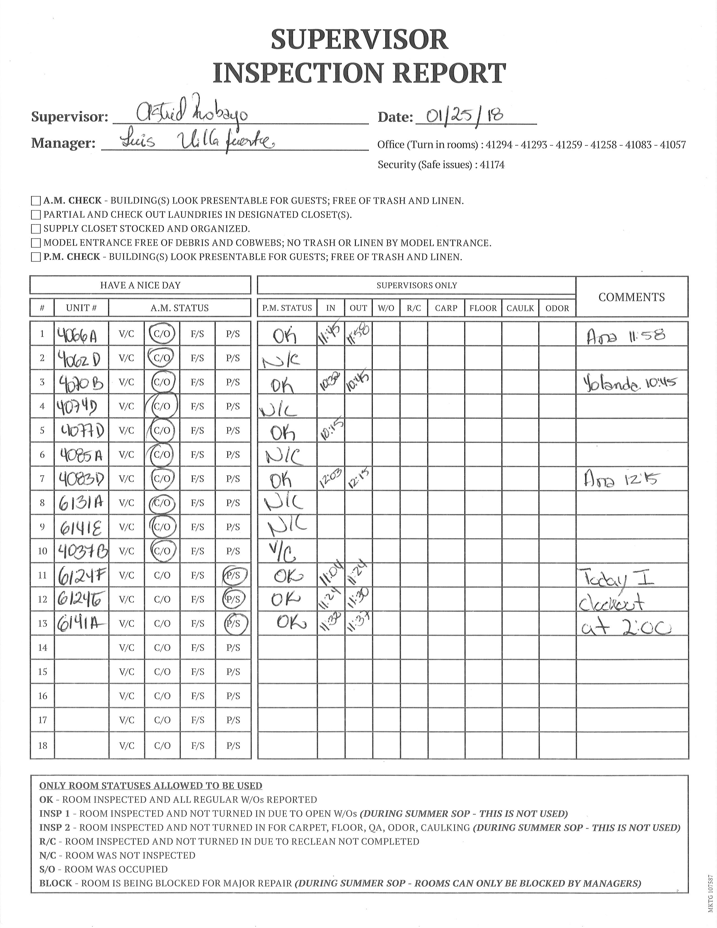
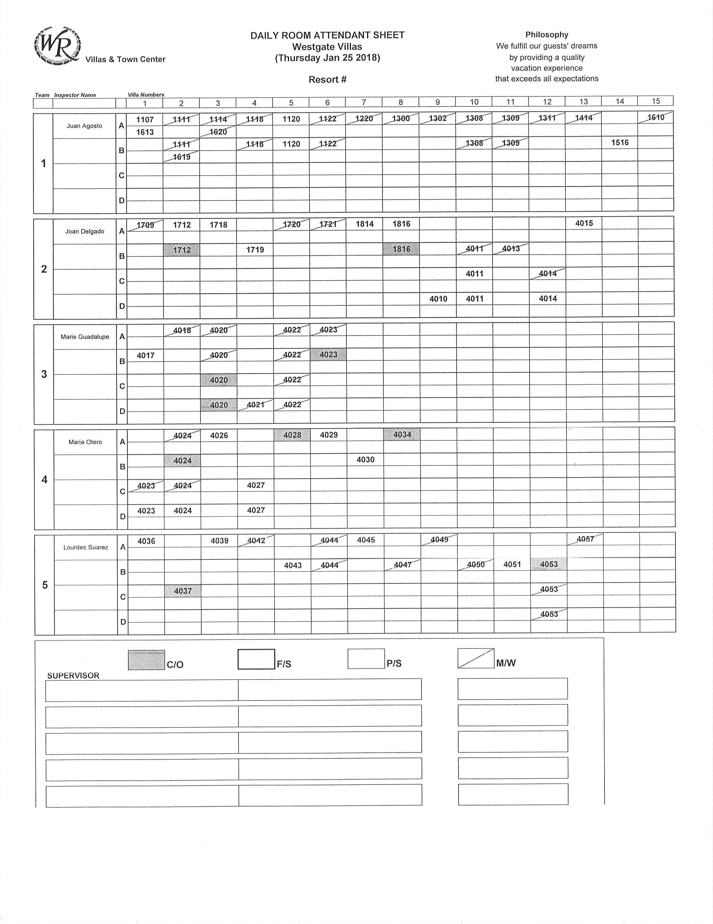
WG Supervisor Forms
Attached you will find the forms used by each WG Housekeeping Supervisor.
Each property will utilize the same Daily Assignment sheet with each Housekeeper’s assignment indicated.

Slide 4
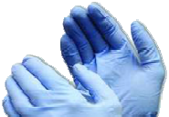







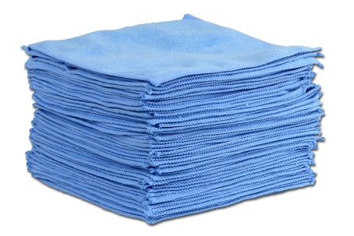


Supervisor Tools
•Toilet
•Glassware
•Touch-ups
•Flat screen TVs
•Bedding
•Floors
•Check for high dusting
•Cleaning Cloth

Slide 5
Unit Inspection Process
Living Room
Bedroom
Bath
Kitchen
Entrance and Hallway
Place inspection tools out of pathway
Begin at the entrance door and move along the wall to the RIGHT or LEFT around the entire unit
Remedy minor issues (no more than five minutes)
Bring WG Housekeeper for re-clean if major issues are found
Ensure Cleaning steps are being conducted
Finalize unit and ready for guest occupancy
(Fresh clean smell, Thermostat set, lights off, all doors, windows secured)

Slide 6
Unit Inspection Checklist
Be prepared with all necessary materials
White rag – floor testing
Blue cleaning rags – touch ups
Dish soap – touch ups
Yellow microfiber rag – flat panel TVs
Lint roller – bedding; floors
Flexible dusting wand – touch ups
Gloves – glassware; toilet
Amenities (if necessary)
Inspect High – Middle – Low
Follow one wall around entire unit
Look at and touch all surfaces
Wear gloves when handling glassware
Use flexible duster or step stool to reach high places
Move quickly within the unit
Complete unit in allotted time

Slide 7




Step 1: Entrance Presentation
Hallway area clean and order free
Surfaces are dirt and dust free
Fixtures and décor are clean placed accordingly
Steps, walkways and entry mat (if applicable) are clean
Safety hazards (if any) identified and reported

Slide 8



Step 2: Kitchen
All surfaces clean
Odor free
Sink and faucet shiny and clean
Appliances are clean and working order
Countertops clean
Coffee presentation
Kitchen set
WG note pad and pen
Safety hazards (if any) identified and reported

Slide 9




Step 3: Dining and Wet Bar Area
Floral décor is centered
Surfaces are dirt and dust free
Chairs are clean
Lighting and fixtures work
Safety hazards (if any) identified and reported

Slide 10




Step 4: Living Room and Balcony Areas
Areas clean and free of debris
Coffee table centered on area rug
Fixtures and décor are clean placed accordingly
Sofa and sleeper is clean and operational
TV on WG channel
Safety hazards (if any) identified and reported

Slide 11



Step 5: Bedroom
Surfaces and area clean
Dust free
Underneath the bed is free of debris
Bedding and linen is clean and stain free
Presentation of bedding as established standard (i.e. WG pillow, blanket and tucked)
Fixtures and décor are clean placed accordingly
Print material placed on nightstand
WG note pad and pen
TV on WG channel
Safety hazards (if any) identified and reported

Slide 12



Step 6: Bathroom
All areas clean and odor free
Mirrors and pictures smear free
Faucets shiny
Vanity tops are residue free
Toweling is clean, stain and tear free
Presentation of amenities as per standard
Whirlpool tub is clean and free of debris

Slide 13



Step 7: Laundry Area
Appliance surface is clean and dust free
Detergent is neatly presented
Lint trap is clean
In and around appliance is clean
Safety hazards (if any) identified and reported

